Slide 1
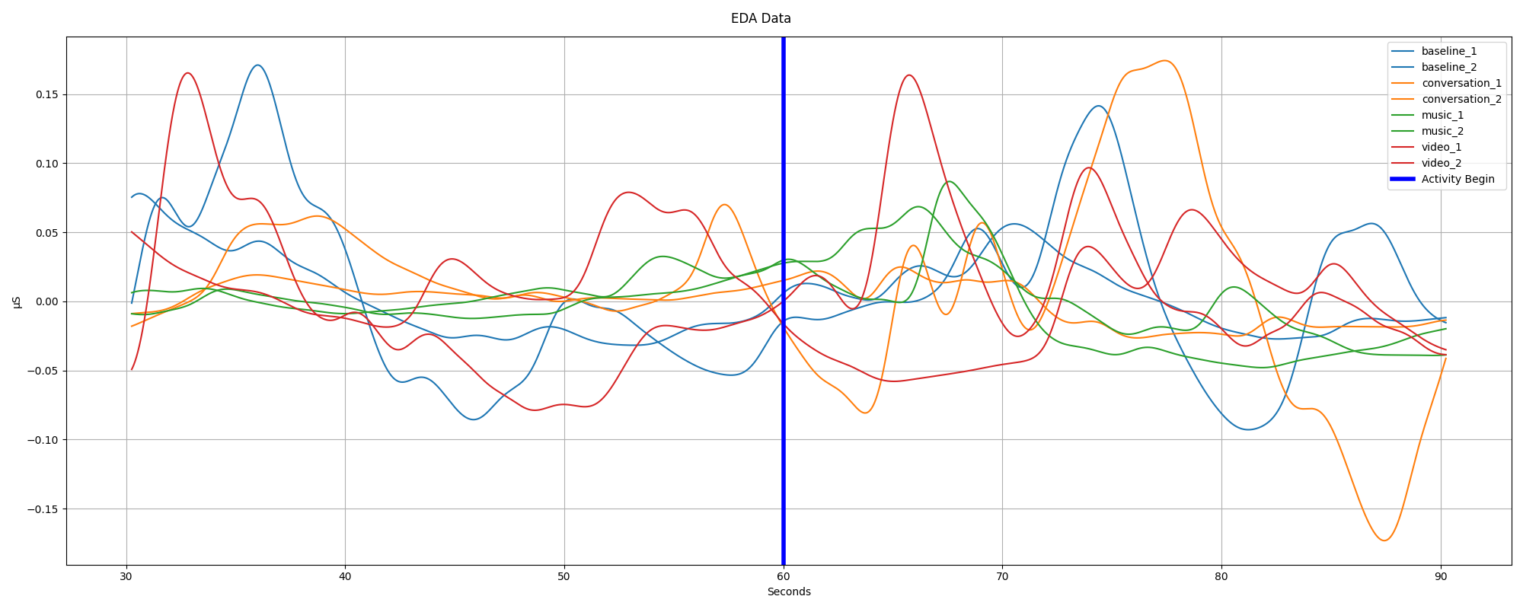
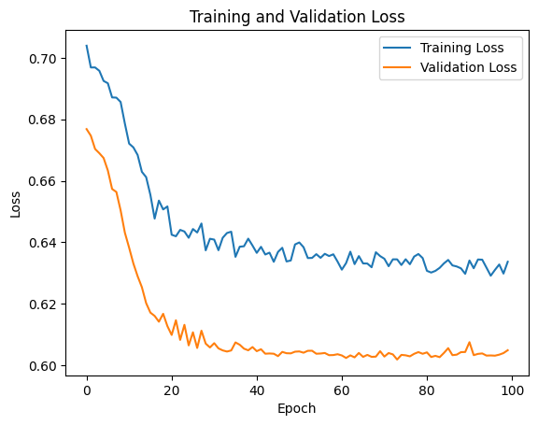
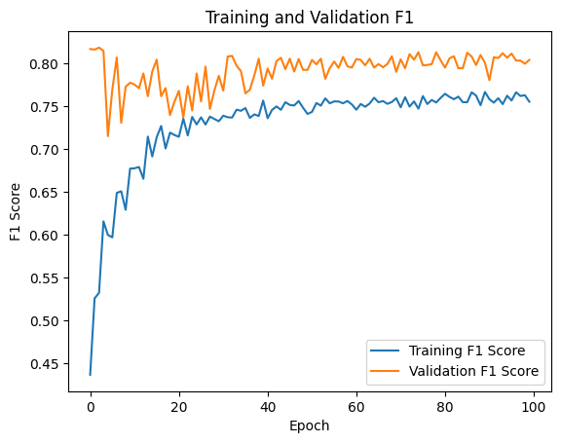
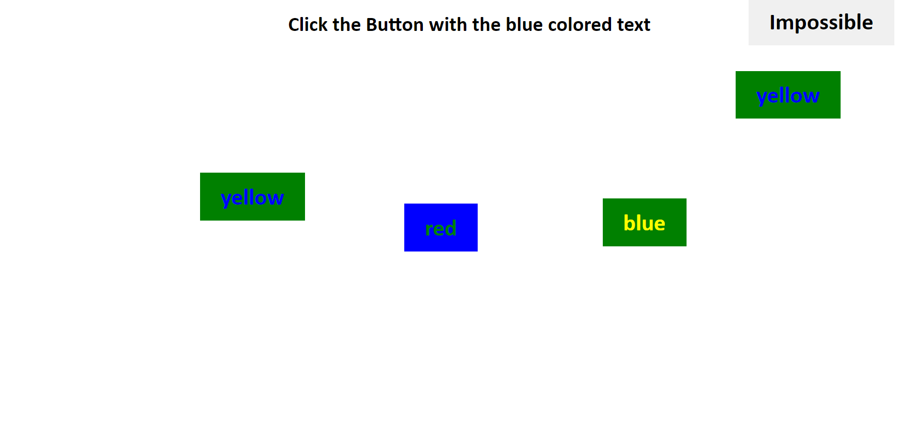
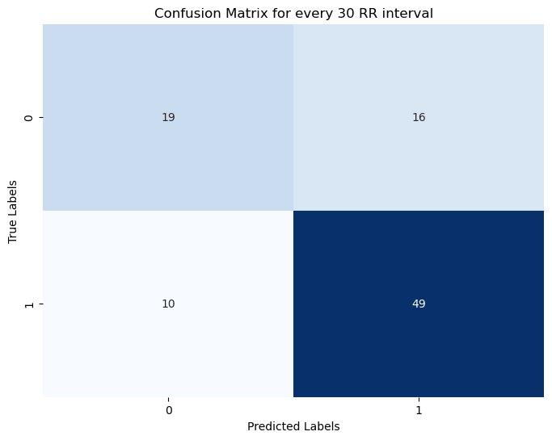
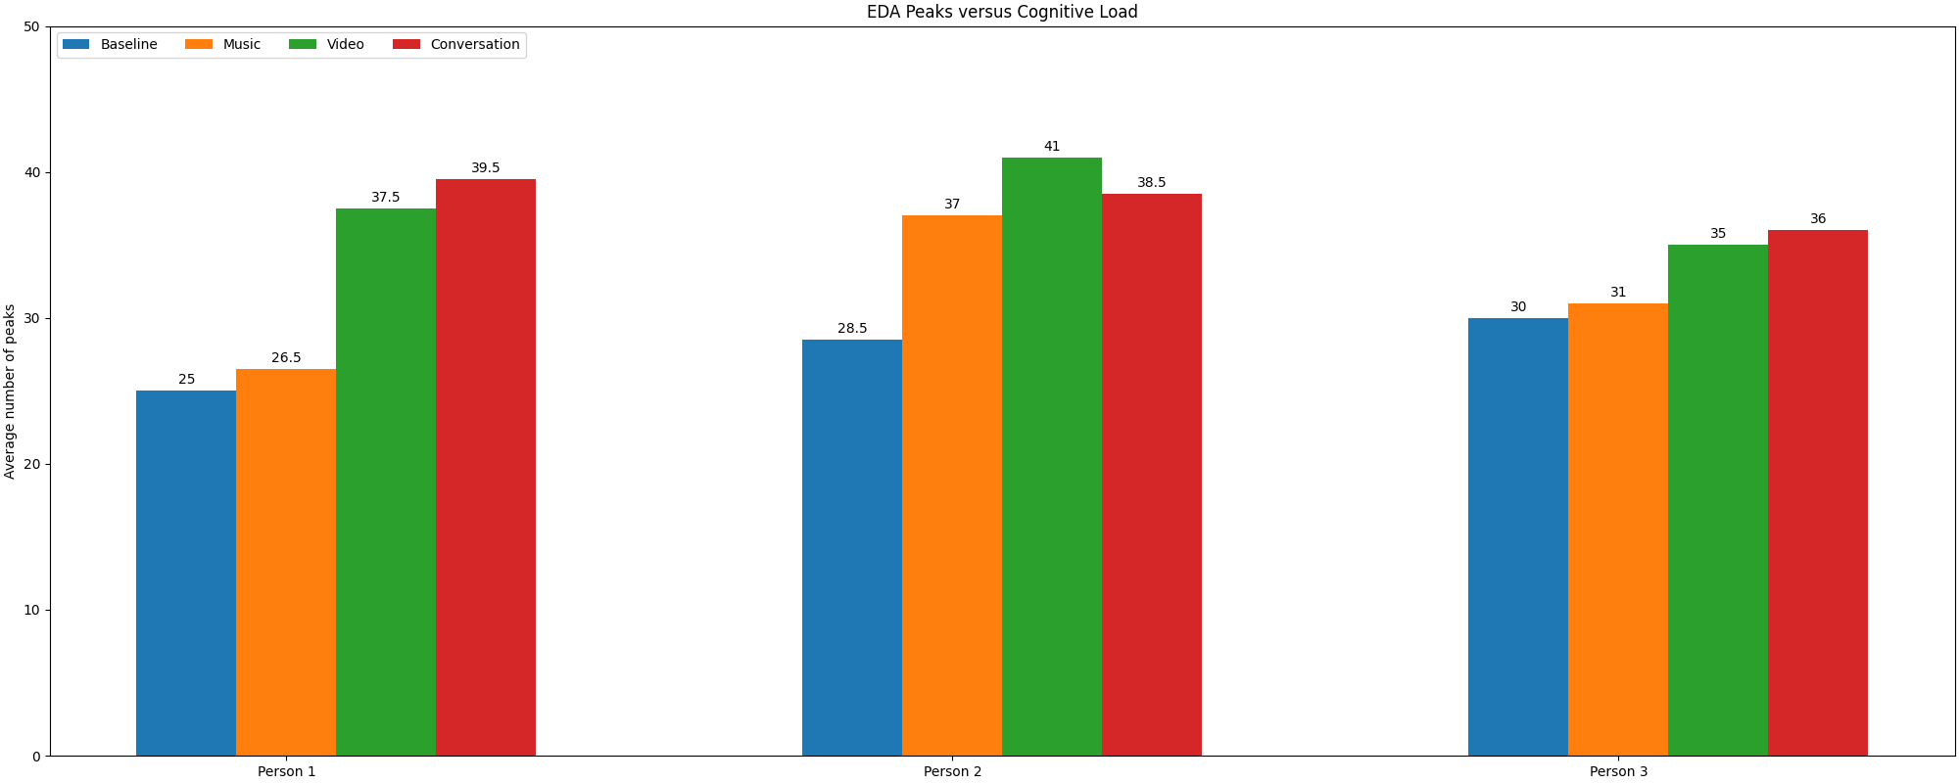
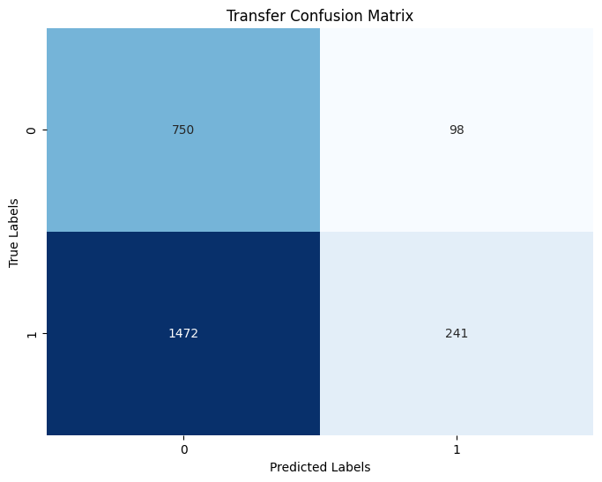
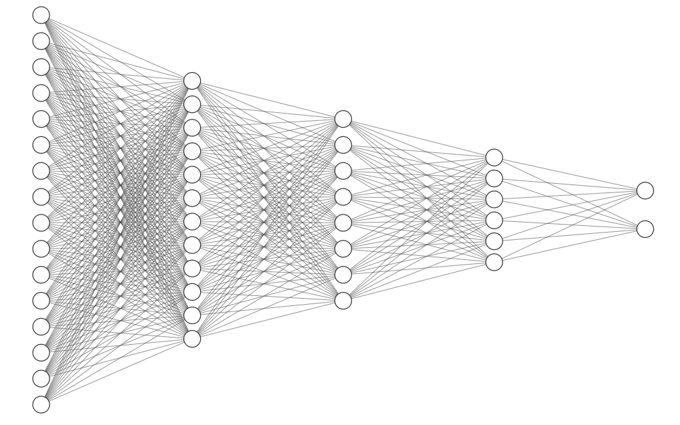
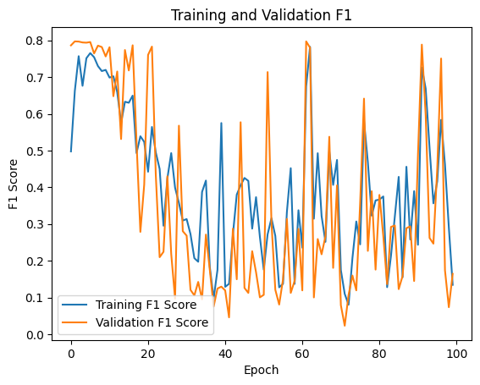
Distraction Detection through Signals
Zeyu Chang, Siddharth Das
Georgia Institute of Technology
Abstract
Methodology
ECG Results
EDA Results
Distraction detection is critical in various contexts, notably in driving scenarios, where it can prevent accidents and ensure safety. We present a novel approach to distraction detection utilizing a limited number of sensors placed on the hand for practicality. We conducted a comprehensive focus test, collecting electrocardiogram (ECG) and electrodermal activity (EDA) data from volunteers engaged in various distraction scenarios. Signal processing techniques, including filtering and peak detection, are applied to the ECG data, followed by classification using a simple neural network. Results demonstrate promising performance on same-subject data, with F1 scores exceeding 75%. Our study highlights the feasibility of hand-worn sensors for distraction detection, underscored by the need for personalized modeling and improved generalization techniques.
Data Collection:
Simulate a scenario that needs focus by writing a webpage with different types of tasks, ranging from color/text recognition to reaction time measurement.
Collect ECG and EDA data from test volunteers while performing the multi-faceted focus test. No other sensors are used and sensors are all placed on the fingers of both hands.
Four different interaction scenarios: baseline, listening to music, watching a video, and having a conversation.
A three-layer fully connected neural network can already perform relatively well when given the ECG signals from the same subject, achieving a non-trivial F1 score of 75~80%.
It’s a filtered EDA signal from a small time snapshot from one person.
The key fact is activities with higher cognitive loads have more EDA peaks on average. Exploiting this fact, we can determine both a baseline and observe the impact of various distracting activities.
When the model is used to test on held-out R-R intervals for every 30 consecutive R-R intervals of the same person, it can give results with an F1 score of above 75%.
Custom-built focus test webpage
Introduction
Signal Processing:
ECG:
Low & High pass filter, Pan Tompkins Algorithm → R-R interval
Fully connected neural network to train on each R-R interval
Incorporate converged model into real time system and classify on every 30 R-R intervals.
EDA:
Utilize a moving average of 0.5 seconds
Utilize a bandpass filter on top of it.
1/3 Hz for the high-pass
1/60 Hz for the low-pass
Extract peaks from the filtered data.
Distraction detection is a hot topic, particularly in the context of driving schemes, such as car driving, train driving, and machinery operation.
With the recent rise in deep learning and neural networks, a lot of recent papers provided a computer vision approach to the problem. There are also papers on using wearable technology with EEG/ECG sensors, combined with machine learning methods, to detect distracted/drowsy driving.
We think a vision approach via CNN is computationally intensive to give quick feedback. At the same time, many approaches using sensors place their sensors on different parts of the body, making it unrealistic to be usable in practice. We aim to come up with a detection mechanism that only uses a limited number of sensors, all placed on the hand for easy wearing.
Transfer learning is not meaningful, and gives bad prediction results
Conclusion
We proposed a method of detecting distraction and reporting in real time, using only limited signal sensors placed on the fingers. We avoided the use of facial expressions and computer vision methods for simpler computation.
Similarly, combining signals from all subjects don’t give a good model
Classification of R-R interval is promising and can give meaningful results when the model is fed with the same person’s signal. False-positive rate can be high in some cases, but so is the True-positive rate. This method requires training a dedicated model for each user.
EDA peak based detection seems viable, but does require access to a baseline state. That requirement is easily met though through real-time analysis, which we are performing. It could be enhanced possibly through a separate model, or be used to try to enhance the R-R model.
Sample Neural Network, Not to Scale

